Slide 1

NEWARK AIRPORT (EWR) flight delays
Mandip Farmahan (dr20)
21 June 2023

Slide 2
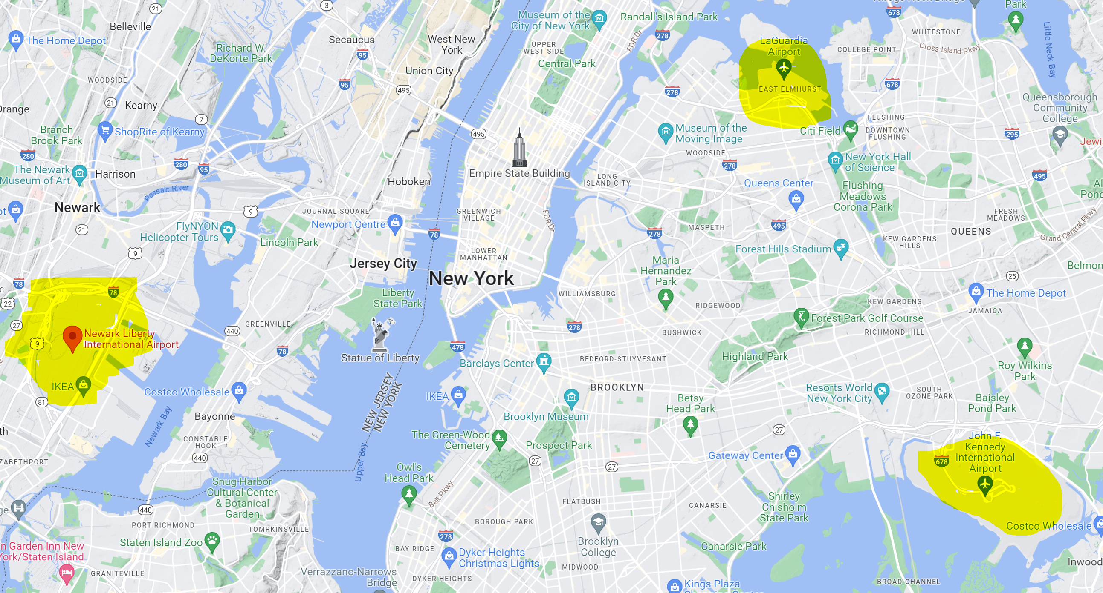
New York and New Jersey Airports
3 main airports
Newark Liberty International Airport (EWR)
John F. Kennedy International Airport (JFK)
LaGuardia Airport (LGA)
Sources of delay
Weather
Runway slots
Flight paths
Notes:
Weather: JFK and LGA are located near water, and EWR is landlocked but all are impacted by bad weather in NY/NJ
Runway slots: In the best of conditions, 79 flights/hour operational cap for EWR imposed by FAA. Lower in bad weather. The data suggests this cap was broken 16 times in 2017.
Flight paths: close proximity of the 3 airports so holding patterns required to clear airspace.

Slide 3
Project remit
“You have been hired by Newark airport to investigate the effect of weather on aeroplane departure delays*. They want to invest in improving facilities so that aircraft can take off in more types of weather. As part of investigating the effect of weather you should investigate other factors to understand how important weather is in comparison to them.”
The scope of this project will therefore focus on the following:
How many flights are affected and is this different from the neighbouring airports (JFK and LGA)?
Are these delays weather related and if so, what elements are causing these delays?
If not weather related, what other factors are causing these delays?
Binary classification of delayed (15 mins or more) vs not delayed (less than 15 mins)
* U.S. Department of Transportation Federal Aviation Administration (FAA) Order JO 7210.55F states the following:
"Delays to instrument flight rules (IFR) traffic of 15 minutes or more, which result from the ATC system detaining an aircraft at the gate, short of the runway, on the runway, on a taxiway, or in a holding configuration anywhere enroute must be reported."

Slide 4
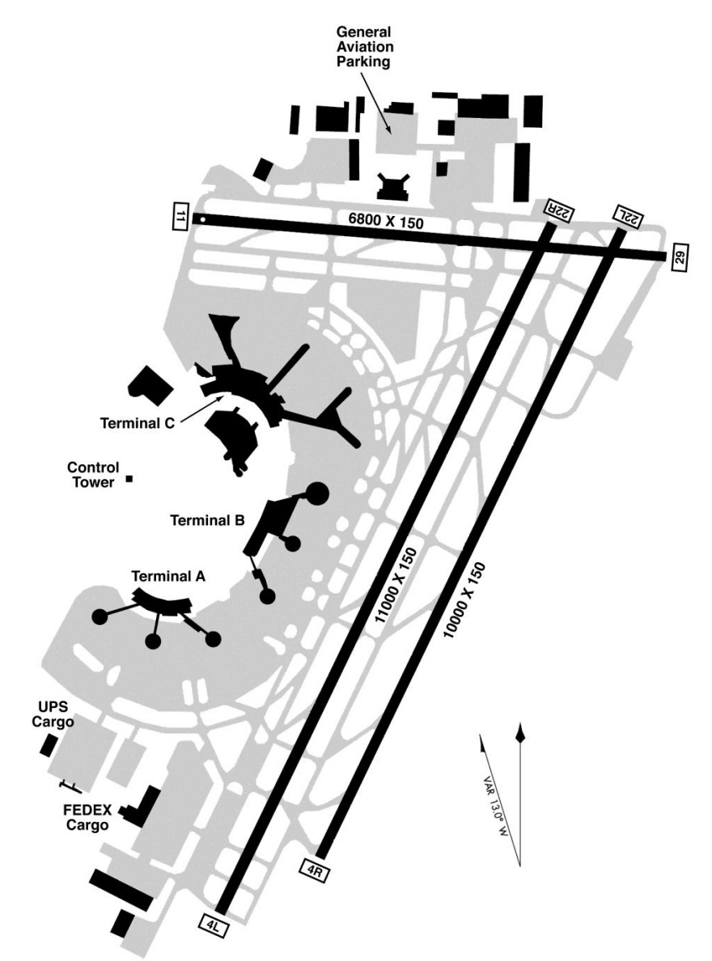
EWR Airport Background
Opened in 1928
3 terminals and 3 runways
11/29 is used by smaller aircraft or when there are strong crosswinds on the two main runways
4R/22L (opened 1952) is used primarily for landings
4L/22R (opened 1970) is used primarily for departures
Port Authority completed a $97 million dollar rehabilitation project of 4L/22R in 2014
EWR was previously a FAA-designated Level 3 (slot-coordinated) airport
In 2016, FAA re-designated EWR a Level 2 (schedule facilitated) airport
2017 annual departure metrics (proportions):
On time – 0.734
Delayed – 0.241
Cancelled – 0.025
Notes:
Expect crosswinds to cause delays or cancellations. Headwinds and tailwinds are not as important.

Slide 5
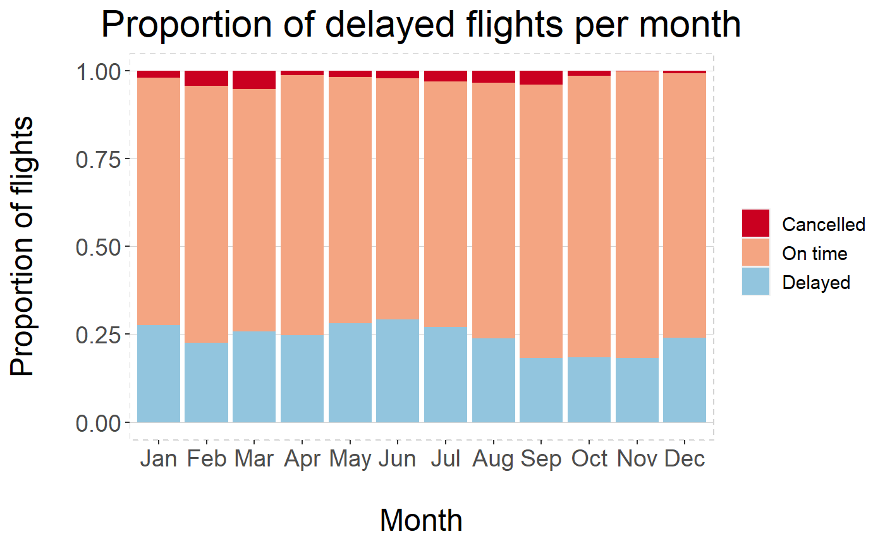
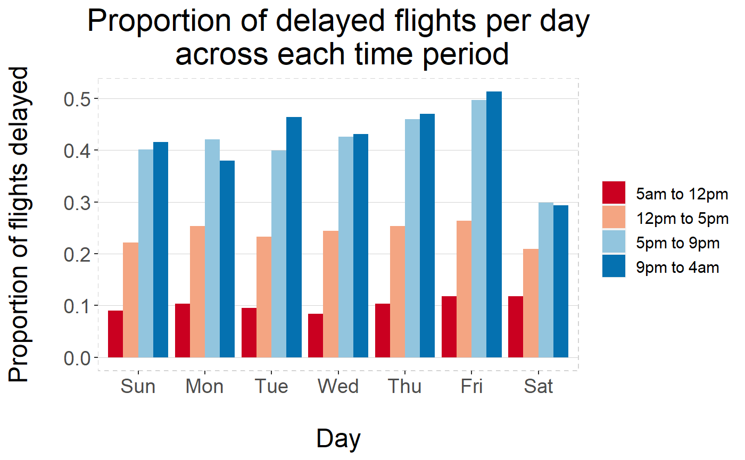
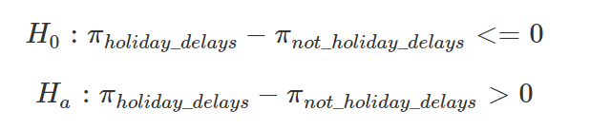
EWR Airport delays
Is there a holiday effect?
There are significantly more delays during the holiday season
Notes:
Flights across the day… Morning: 40% - Afternoon: 30% - Evening: 25% - Night: 5%
Monthly trends: higher prop of delays in Jan, Mar, May, Jun and Dec (Christmas, Spring break and Summer)
Busiest months (flight numbers) in Aug, then Mar to Oct.
Lightest month is Feb
Holiday stats (March, June, Jul, Aug, Dec): independence test using permute; diff in proportions and diff in means
Daily trends: same traffic everyday except Saturday (less flights). Looks ok in morning with a small number of delays. This gets worse as day progresses as flight delays cannot catch up, even with less flights later in the day.

Slide 6
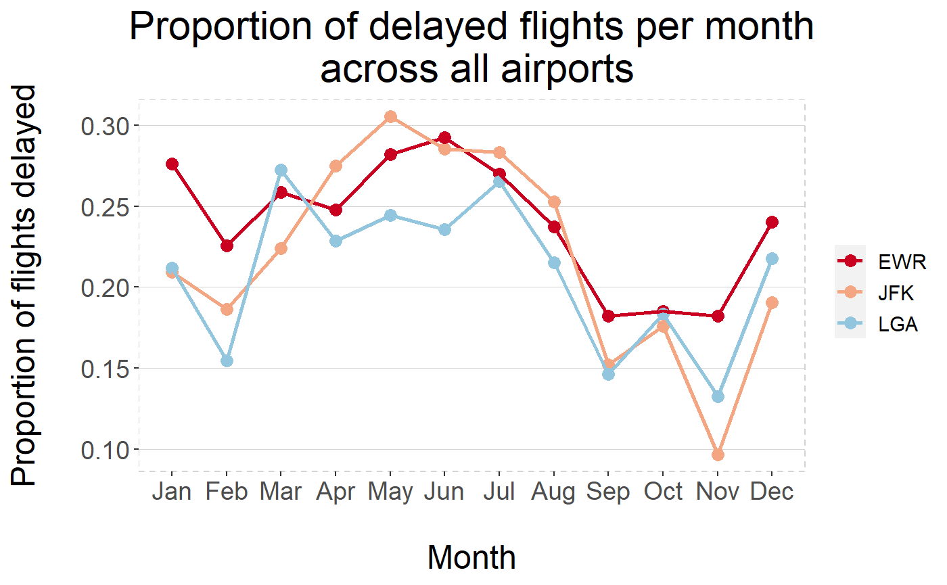
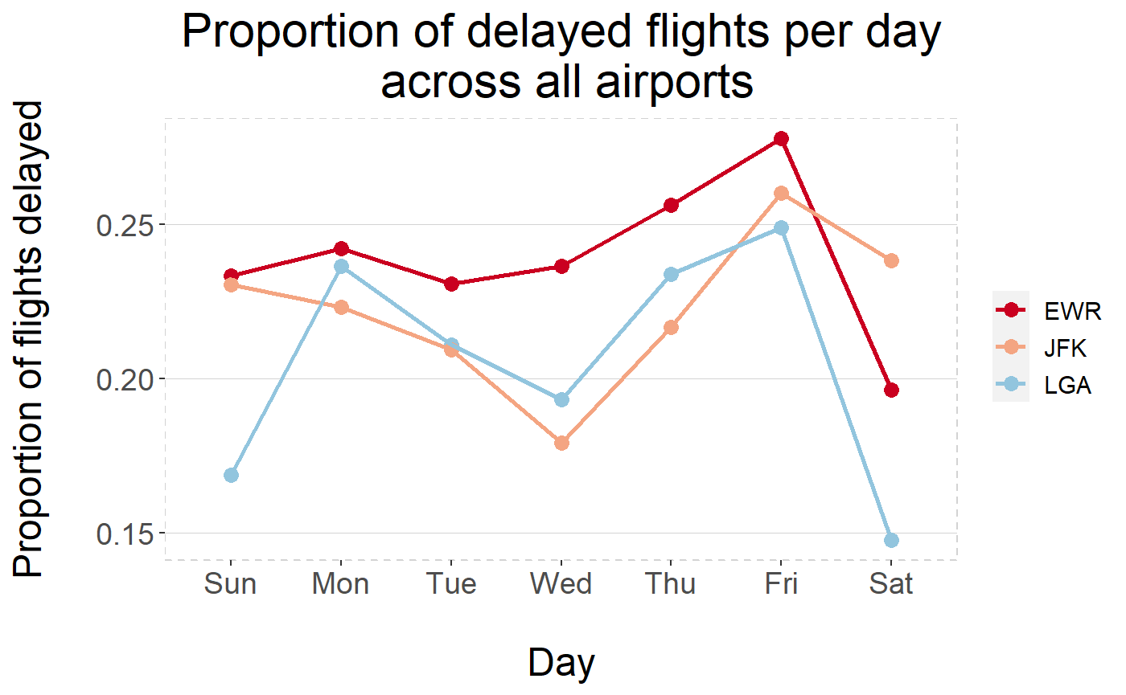
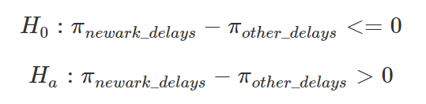
Comparison of Airport delays
Is there an airport effect?
Proportion of delays at EWR are significantly higher than neighbouring airports
Notes:
Monthly flights
EWR: 10k, LGA/JFK: 7-8k
Daily flights
EWR: 17k (Sat 13k), LGA: 14k (Sat 9k), JFK: 14k (Sat 12k)

Slide 7
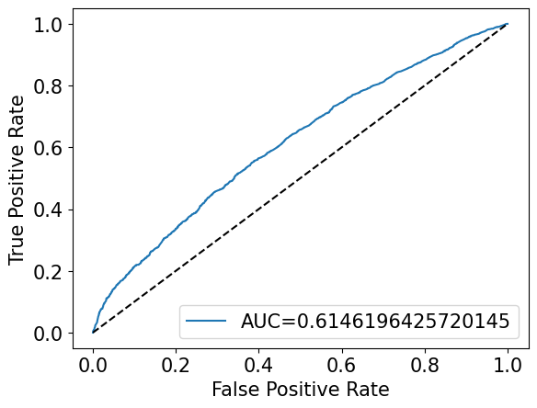
Weather related delay factors
Original data:
Wind direction (wind_dir), wind speed (wind_speed) and visibility (visib)
Alternative data sourced (NOAA and Meteostat):
Temperature (tavg), precipitation (prcp), snow fall (snow) and snow depth (snwd)
Air pressure (pres)
Random Forest Classifier Model built in Python after model and parameter tuning
Variable | Importance
prcp | 0.37
pres | 0.21
visib | 0.17
tavg | 0.10
snwd | 0.10
wind_dir | 0.03
wind_speed | 0.02
snow | 0.01
Notes:
Original weather data provided had lots of missing values so enhanced with data from free weather sites.
Tested: LinearRegression, LogisticRegression, RandomForestClassifier, DecisionTreeClassifier, RandomForestRegressor, KNeighborsRegressor, Ridge, Lasso, GaussianNB
Used supervised classification model
AUC indicates how well the model can distinguish between 2 classes.
AUC of 0 shows 100% of predictions were wrong. AUC of 1 shows 100% of predictions were correct.
Recall = TP / (TP + FN)
Precision = TP / (TP + FP)
Accuracy = (TP + TN) / Total
No information on terminals (old data and some of these airlines have been taken over etc). Splitting by terminal may have led to more affect of crosswinds due to runway orientation.

Slide 8
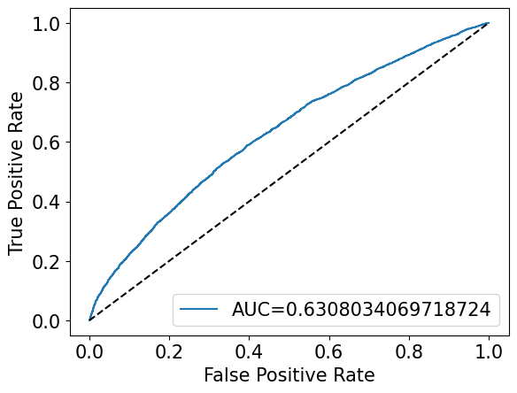
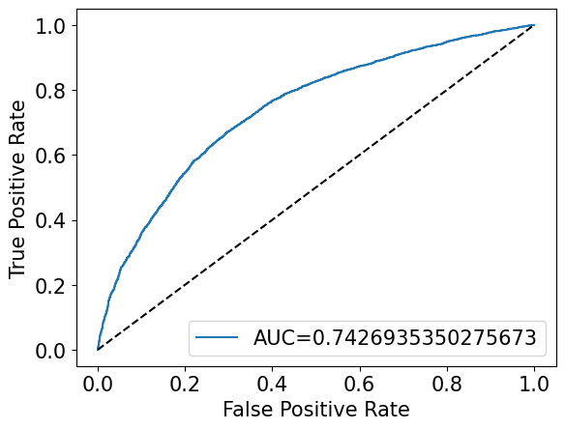
Other delay factors
Weather
Plane and flight related factors
Destination, flight distance, flight direction, carrier, type of plane, seats
Weather
Plane and flight related factors
Destination, flight distance, flight direction, carrier, type of plane, seats
Airport traffic
Month, day of week, hour, cycle, flights per day, flights per hour
Variable | Importance
prcp | 0.15
pres | 0.13
visib | 0.13
snwd | 0.08
tavg | 0.07
carrier_JetBlue | 0.06
Seats | 0.05
Distance | 0.04
carrier_JetBlue | 0.04
wind_dir | 0.03
Variable | Importance
hour | 0.24
cycle_Morning | 0.16
cycle_Evening | 0.16
prcp | 0.06
flights_per_hour | 0.05
cycle_Night | 0.05
pres | 0.04
month | 0.04
visib | 0.03
tavg | 0.02
Only top 10 shown
Only top 10 shown
Notes:
Flight direction calculated from origin and destination long/lat

Slide 9
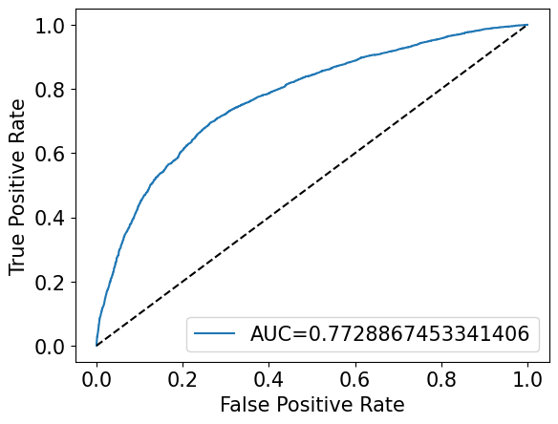
Final Model
Final predictors:
Weather (4): precipitation (prcp), air pressure (pres), temperature (tavg), visibility (visib)
Airport traffic (4): time of day (hour), flights per day, flights per hour, month
Variable | Importance
hour | 0.58
flights_per_day | 0.11
prcp | 0.09
pres | 0.07
tavg | 0.06
month | 0.04
flights_per_hour | 0.04
visib | 0.01
EWR model with JFK data
AUC = 0.694
EWR model with LGA data
AUC = 0.720
Notes:
Hours highly correlated with cycle so cycle removed.
3 of the weather variables were not included in the original data set (missing values)

Slide 10
Conclusions and Recommendations
24% of flights from EWR in 2017 had departure delays
Weather alone is not responsible for departure delays
Weather related airport improvements unlikely to cause a decrease in departure delays
Time of flight (58%) and number flights per day are most important
40% of flights are in the morning and only 5% at night
Flights should be more evenly spread across the day or reduce total number of flights
Delays in general are worse at EWR than LGA and JFK
More flights leave from EWR
Final model indicates flights from all NY and NJ airports are affected by similar factors
To fully investigate the influence of wind speed and direction, terminal-specific data is required
Notes:
Look into using larger aircrafts to combine flights to same destination?
Overbooked flights?
Staffing issues?

Slide 11
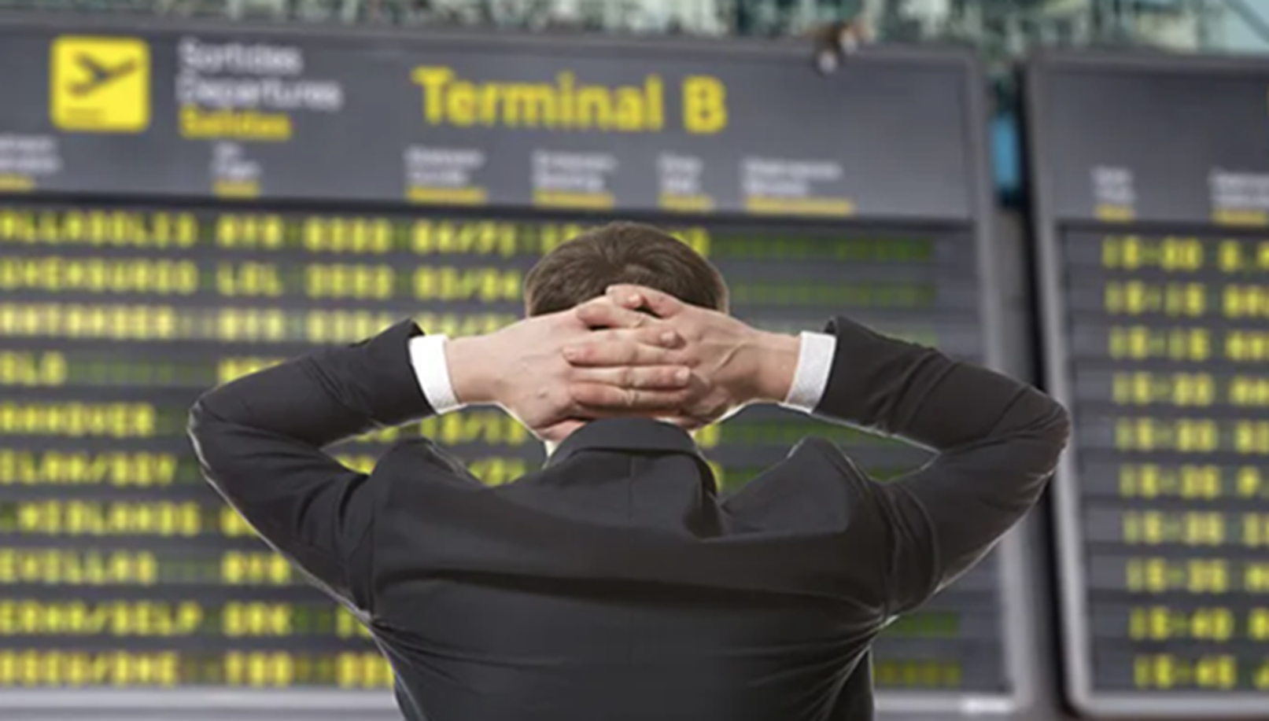
Thank You

